Slide 1
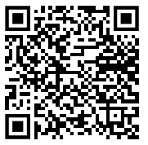
Practical Ideas for Neurodiversity-Affirming Services
Find these slides on Google Drive! (And “File” > “Download” if you like!)
Reed Senter, Ph.D. CCC-SLP, BCS-CL
Notes:
https://docs.google.com/presentation/d/1yXsfw53fknj08fLbDbGpkhYFdrDr_tw0fZId-2iz41M/edit?usp=sharing

Slide 2
Disclosures
Financial:
I am a salaried, full time Assistant Professor of Speech-Language Pathology at DeSales University.
Non-financial:
I am autistic.

Slide 3
What are neurodiversity-affirming services?

Slide 4
…And where did these principles come from?
“Promoting neurodiversity-affirming care for autistic children: A scoping review”
Wagland et al., 2025
“Defining neurodiversity affirming psychology practice for autistic adults: A Delphi study”
Flower et al., 2025
“Neurodiversity-affirming practice: A work in progress”
Penrod, 2025 (The Informed SLP)

Slide 5
What are “neurodiversity-affirming principles?”
But how???
A commitment to continued learning about autism**
Providing safety to be one’s autistic self
Finding a way to communicate
Authenticity and humility in practice
Validation of autistic experiences
6. Autistic-informed, person-centered support
7. Genuine acceptance and appreciation of autism
8. Educate non-autistic people about autism
9. Prioritize well-being over compliance

Slide 6
Clinical service delivery
Assessment
Treatment planning
Intervention
WHO-ICF framework

Slide 7
Back to the roots
Neurodiversity- affirming services
Are an applied extension of…
The social model of disability

Slide 8
Back to the roots
Neurodiversity- affirming services
Are an applied extension of…
The social model of disability
Which is an ideology that…
Challenges “deficit” perspectives of disability
Emphasizes the interaction between the individual and society
Promotes inclusive, accessible spaces

Slide 9
Back to the roots
Are an applied extension of…
Neurodiversity- affirming services
Are an applied extension of…
The social model of disability
Which is an ideology that…
Challenges “deficit” perspectives of disability
Emphasizes the interaction between the individual and society
Promotes inclusive, accessible spaces
Is a clinical perspective to classify disability, that…
The WHO-ICF framework

Slide 10
The World Health Organization’s
International Classification of Functioning, Disability, and Health
aka, the ICF framework
aka, the blueprint to your assessment

Slide 11
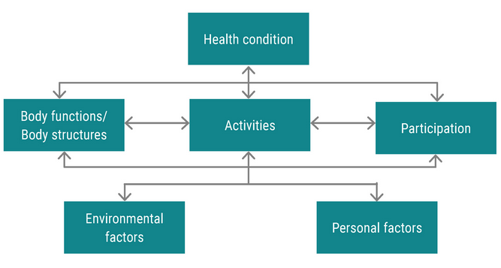

Slide 12
Clinical / Medical diagnosis
Might come from SLP (e.g., DLD, stuttering), might not (e.g., autism, ADHD)

Slide 13
“Traditional” assessment data
Structure: Oral mech exam…
Function: Standard scores, communication characteristics…

Slide 14
Functional, meaningful, assessment data
Client & caregiver interviews, observation, dynamic assessment, QOL/ADL checklists…

Slide 15
Includes factors such as family, work, governmental agencies, laws, culture…
Intake data, observation, client & caregiver interviews…

Slide 16
Includes factors such as race, gender, education, motivation…
Intake data, observation, client & caregiver interviews…

Slide 17

A thorough assessment gathers data from:

Slide 18
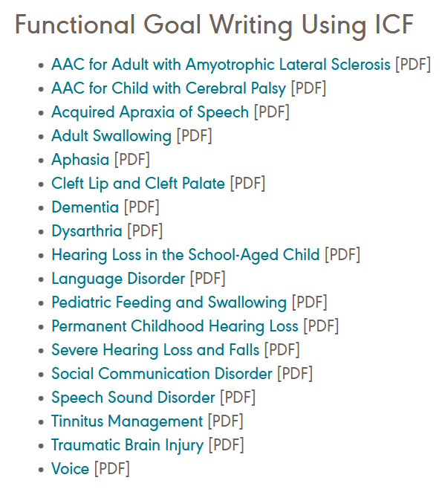
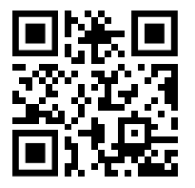
Clinical Resource: ASHA
https://www.asha.org/slp/icf/
Notes:
https://www.asha.org/slp/icf/

Slide 19
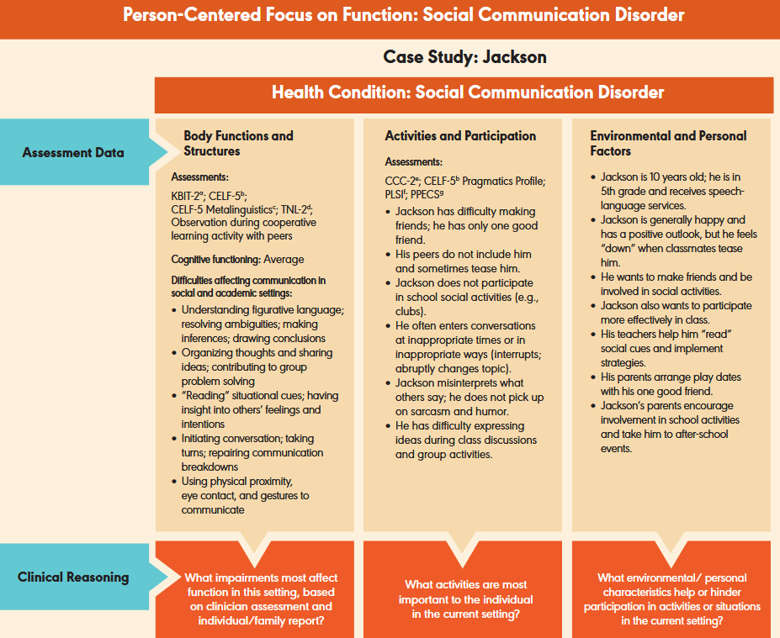
Example
(courtesy ASHA)

Slide 20
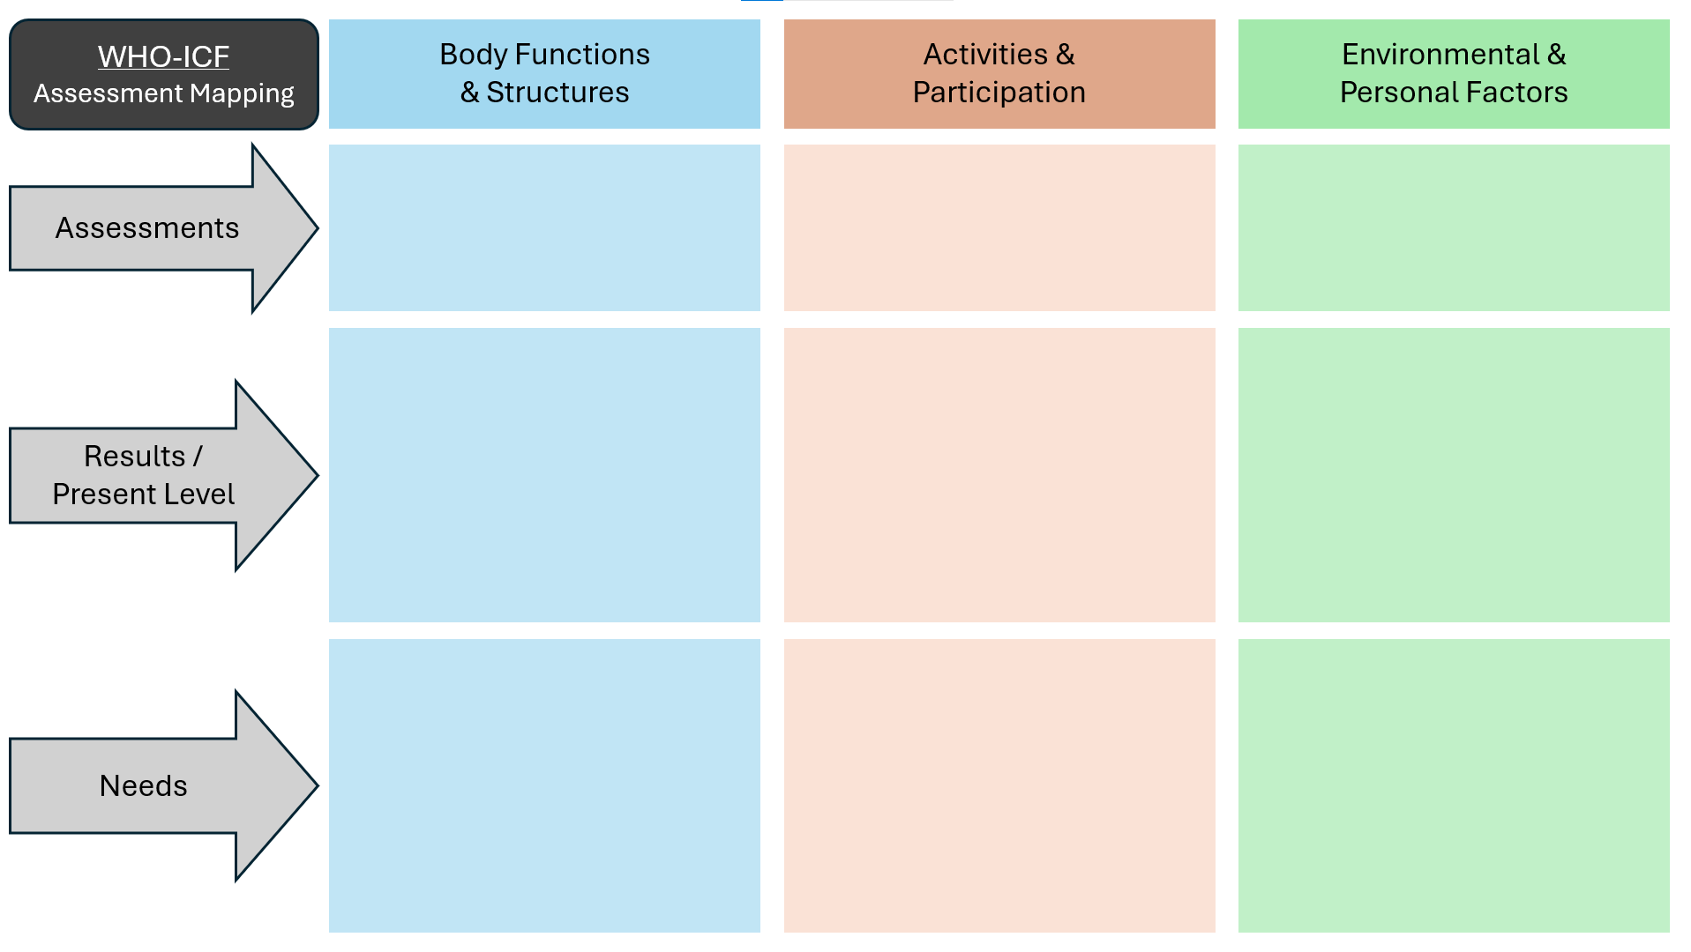
Free resource!

Slide 21
The ICF framework + neurodiversity-affirming services
Pros:
Provides scaffold to ensure thorough data collection
Examines how individual characteristics and societal influences impact activity/participation
Palatable to non-ND stakeholders (e.g., insurance, school districts…)
Cautions:
Pathologizes neurodivergence
Views environment/society as one factor (not core factor)

Slide 22
Clinical service delivery
Assessment
Treatment planning
Intervention
WHO-ICF framework
FOURC model

Slide 23
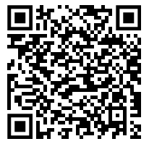
The FOURC Model of Collaborative Goalsetting
Created by Dr. Haley & colleagues
Designed for adults with aphasia
Adapted across various settings
https://www.med.unc.edu/healthsciences/sphs/card/resources/aphasia-goals/fourc-model/

Slide 24
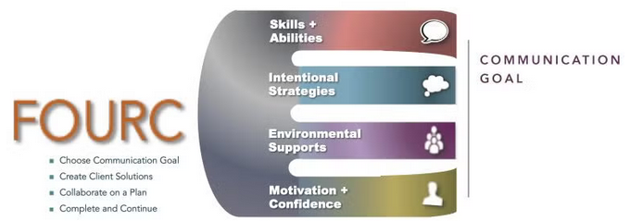
Four steps (all beginning with “C”)
Four prongs (developed in steps 2-4)

Slide 25
Step 1: Choose a communication goal
Examples for patients with aphasia:
“Respond to text messages by myself”
“Talk as if I don’t have aphasia at my class reunion”
“Communicate to show my intelligence”
Examples for ND clients:
“Communicate confidently and clearly”
“Study more effectively and stay organized to pass my biology class”
“Make friends at college”
“Be more flexible in my routine”

Slide 26
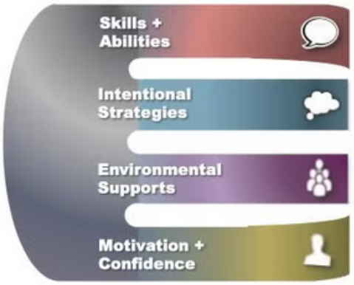
Steps 2-3: Create client solutions, Collaborate on a plan
Client solutions:
Driven by client
SLP supports as needed
Collaborate on a plan:
SLP suggests other ideas as needed
Caregiver(s) and collaborator(s) weigh in
Client considers suggestions

Slide 27
Steps 2-3: Create client solutions, Collaborate on a plan
Skills and abilities:
Wants to type “yes,” “no,” “ok” independently
Difficulty with word-finding
Intentional strategies:
Sending pictures via text
Circumlocution and conversational repair
Aphasia case studies
Haley et al., 2023

Slide 28
Steps 2-3: Create client solutions, Collaborate on a plan
Skills and abilities:
Wants to reduce dysfluencies and maintain a train of thought
Wants to improve study habits
Intentional strategies:
Conversational repair strategies
Scaffolding large tasks
Self-advocacy scripts
Case studies of neurodivergent clients

Slide 29
Steps 2-3: Create client solutions, Collaborate on a plan
Environmental supports:
Communication partner training
Whiteboard
Confidence & motivation:
Practicing with real text messages; using “overlearned” scripts to boost confidence
Aphasia case studies
Haley et al., 2023

Slide 30
Steps 2-3: Create client solutions, Collaborate on a plan
Environmental supports:
Bullet journaling
Conversational “props”
The presence of a familiar, supportive friend
Confidence & motivation:
Openly discussing neurodivergent identity
Finding communities based on shared identity (e.g., neurodivergence) or interests (e.g., anime)
Case studies of neurodivergent clients

Slide 31
Step 4: Complete and continue
Continue with treatment plan?
Modify goals–more ambitious?
Modify goals–target different skills/domains?
Adjust services–build on what works, what doesn’t?
Adjust services–reduce frequency or intensity?
Discharge?

Slide 32
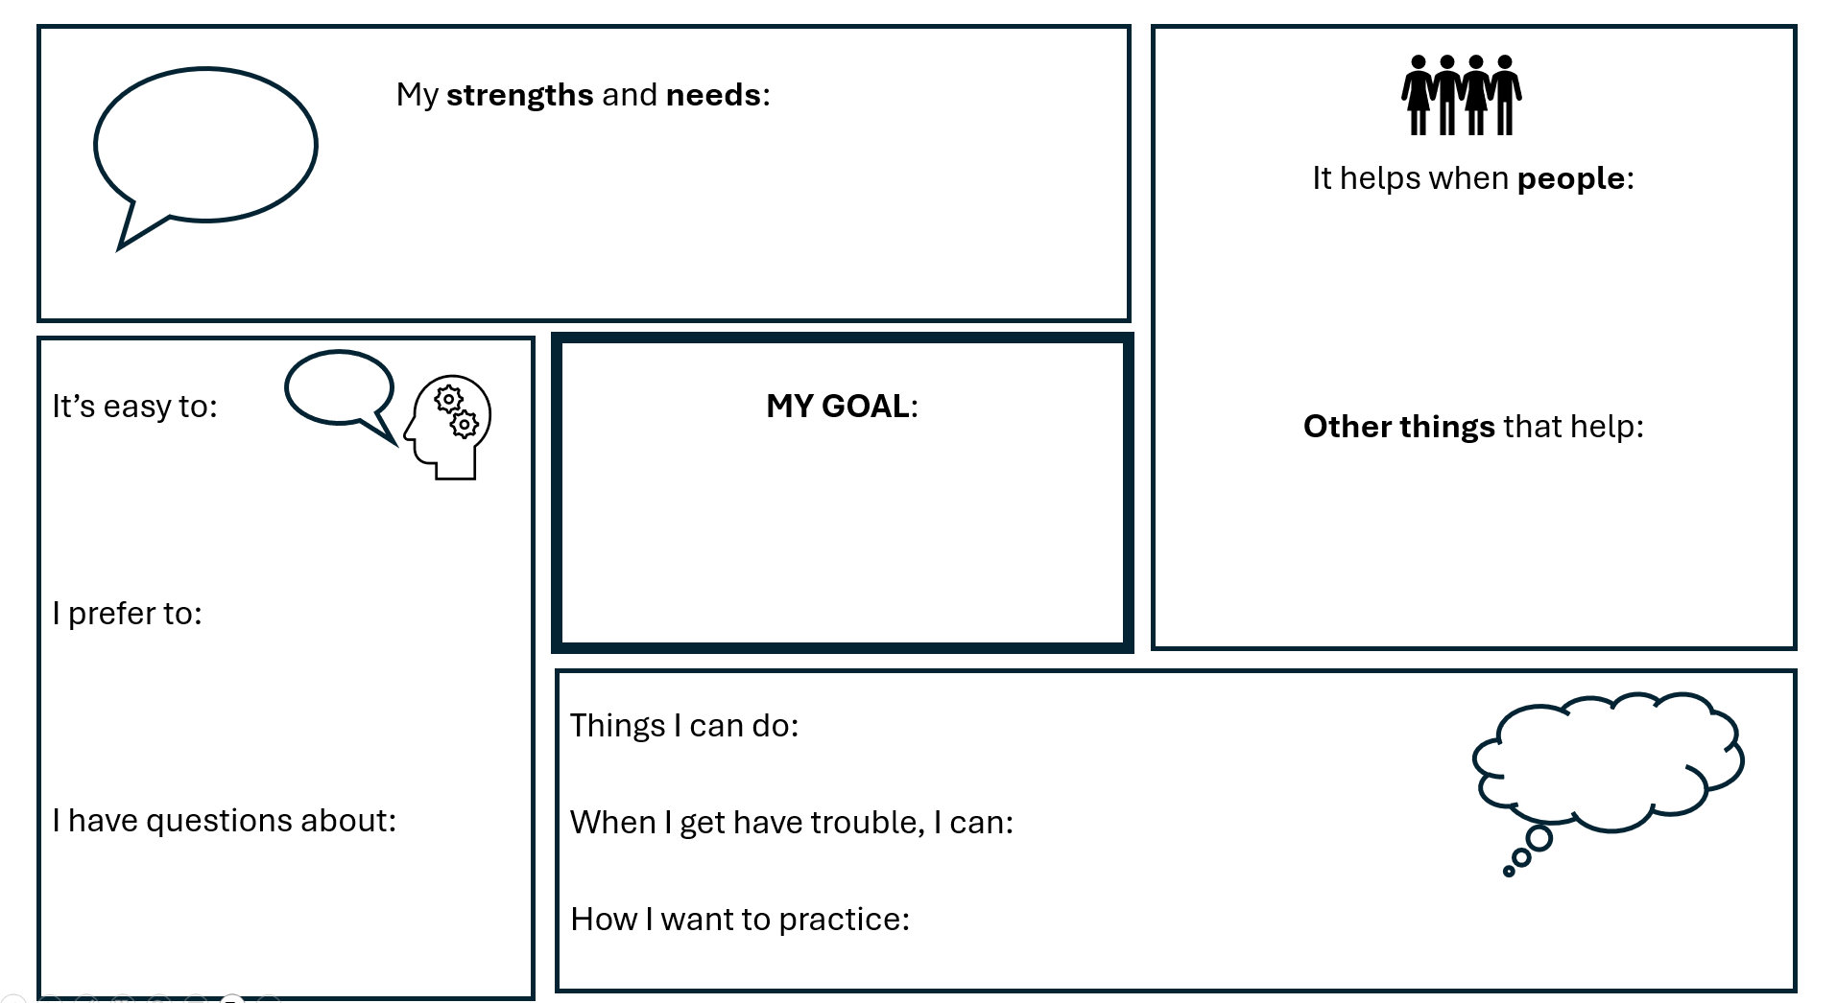

Slide 33
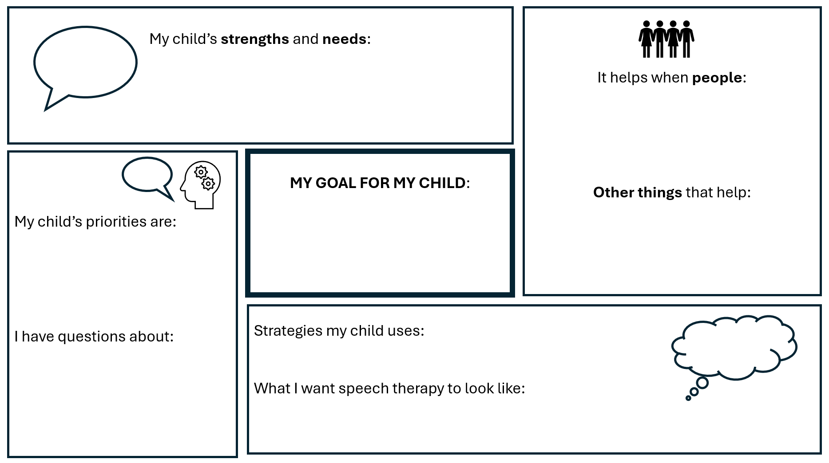

Slide 34
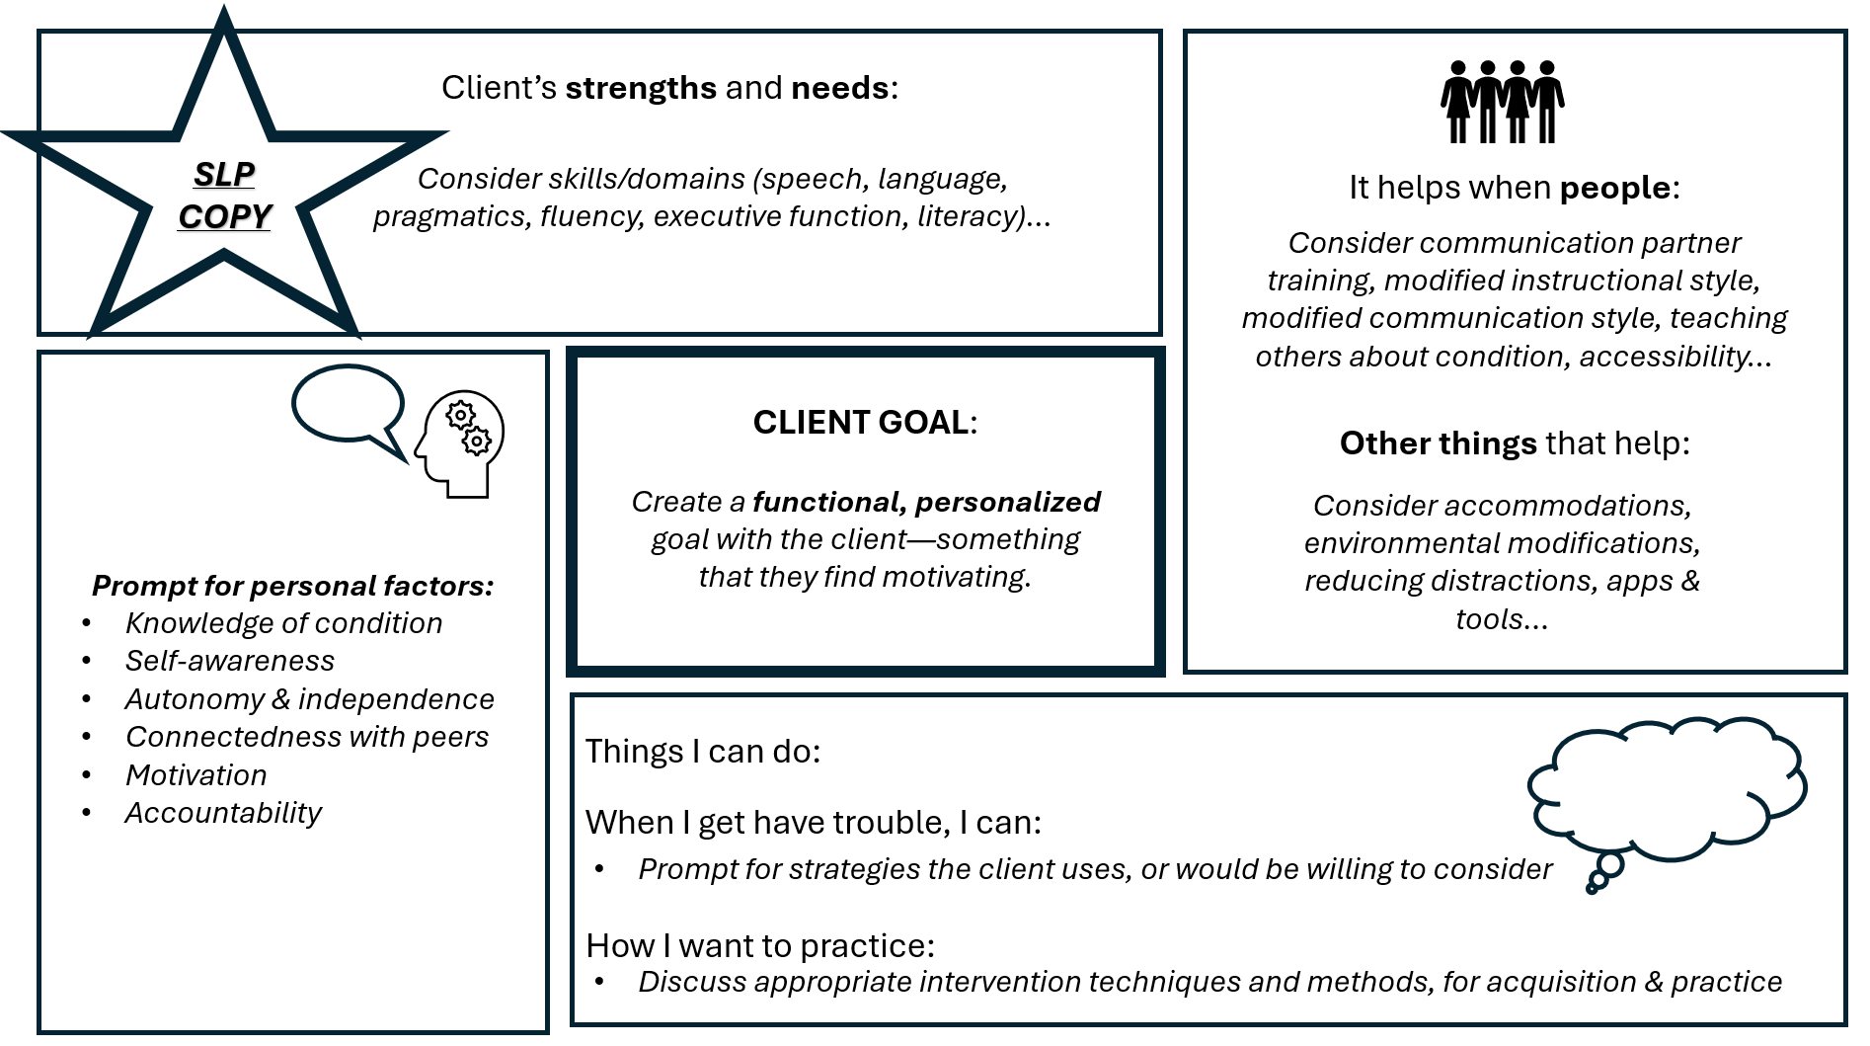

Slide 35
Clinical service delivery
Assessment
Treatment planning
Intervention
WHO-ICF framework
FOURC model
Bring it all together!

Slide 36
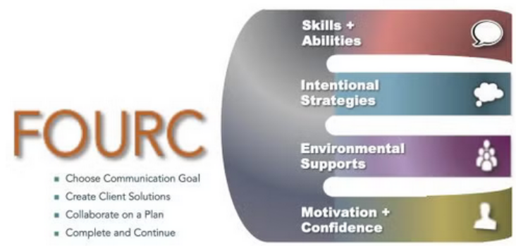

Slide 37
2-3a: Skills & abilities
4: Complete & continue
1: Choose communication goal
2-3b: Intentional strategies
2-3c: Environmental supports
2-3d: Confidence & motivation

Slide 38
What are “neurodiversity-affirming principles?”
You’re here, aren’t you?
A commitment to continued learning about autism
Providing safety to be one’s autistic self
Finding a way to communicate
Authenticity and humility in practice
Validation of autistic experiences
Can implement in your clinical approach
6. Autistic-informed, person-centered support
7. Genuine acceptance and appreciation of autism
8. Educate non-autistic people about autism
9. Prioritize well-being over compliance
Can implement in your clinical approach
Caregiver/communication training? Environmental supports? Self-advocacy?

Slide 39
Case Study
Client: “L.S.”
19F
Pre-med track at local university
Diagnosed autistic at age 17
Self-referred w/mother’s input
Resurgence of speech sound errors impacting clarity
Concerns about pragmatic communication
Executive function difficulties

Slide 40
Step 1: Choose communication goal(s)
“Communicate confidently and clearly”
When speaking with mother on the phone
With unfamiliar communication partners
“Be more flexible in my routine”

Slide 41
Steps 2-3: Create client solutions; Collaborate on a plan
Skills & abilities: Concerned about word-finding, mispronouncing words
Modified speech motor chaining (select target words, then progress from word -> phrase -> sentence in sequence)
Instruction in conversational “place-holding”
Intentional strategies:
Conversational repair strategies
Maintain a schedule
Scheduling unstructured free time/self-care
Prepare set of “alternate” activities/tasks
Environmental supports:
“Caregiver communication training”
Confidence & motivation:
Recording speech & self-evaluation
Open discussion of autistic communication

Slide 42
Step 4: Complete & continue
Reported increased confidence in communication
Reported consistent implementation of strategies
Chose to discontinue services at the end of the 8-week semester

Slide 43
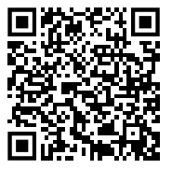
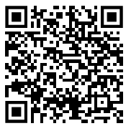
Questions? Thoughts?
Reed Senter
Reed.Senter@desales.edu
Download my FOURC handout:
Download my WHO-ICF handout:
Notes:
http://raw.githubusercontent.com/rrsenter/MyWebsite/gh-pages/FOURC_handout_Senter.pptx
http://raw.githubusercontent.com/rrsenter/MyWebsite/gh-pages/WHO ICF handout_Senter.pptx

